Slide 1


Travi-Navi: Self-deployable
Indoor Navigation System
Yuanqing Zheng, Guobin (Jacky) Shen, Liqun Li,
Chunshui Zhao, Mo Li, Feng Zhao

Slide 2
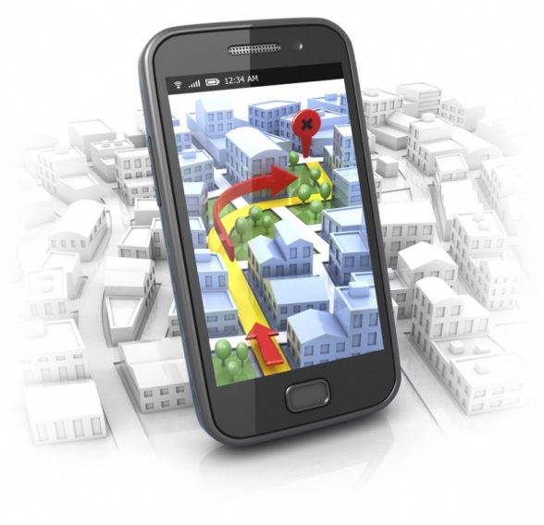
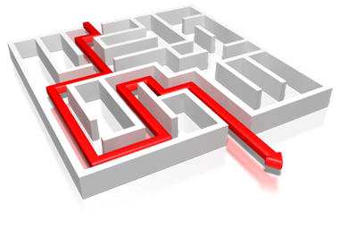
  Indoor navigation is yet to come
Navigation := Localization/Tracking + Map
Notes:
15+ years of research, X000+ research papers
X00+ startups, Google: 11k+ Bing: catching up quickly
Indoor localization and navigation is yet to come and remaining as one of the grand challenges in mobile computing.
When talking about navigation, it is normative to think of providing directions on actual positions and on real map.

Slide 3
  Navigation := Localization+ Map
Localization accuracy?
Map availability?
Crowdsourcing?
Lacking of (no confidence in finding) killer apps!
How to incentivize?
Chicken & Egg problem!
Notes:
However, obtaining high quality maps itself is a challenging task, especially to obtain them at scale, say millions of buildings world wide. Several research proposals like UnLoc, our Walkie-Markie, and Jigsaw (presented yesterday) try to build maps through crowdsourcing. The incentive mechanism design is hard.
In practice, however, the localization accuracy can be improved by deploying dense infrastructures, like APs or beacons. Or business can perform dense war-walking to collect dense location database. So, the biggest challenge is the lack of killer apps, which is killer enough to justify the deployment cost of the IPS.
People have been search hard for killer apps, but none seem to have emerged. Worse even, people seem not to have enough confidence in finding a killer app.
Thus, there is a C&E problem: no business willing to investigate IPS, which make it impossible for user to form a habit/dependency.
For these reasons, we conclude that it is very hard to bootstrap indoor navigation services in practice.

Slide 4


  Our perspective
Self-motivated users
  Shop owners
  Early comers
Make it easy to build and deploy
  Minimum assumption (e.g., no map)
Immediate value proposition
Notes:
In this work, we set out to re-examine our perception of indoor navigation.
While there is no generic killer app for every user, some users want to use it more than others;
while they are not needed all the time or frequently, people do need them occasionally.
In many scenarios, we find that there are many self-motivated users that would directly benefit from an indoor navigation services,
Can we enable them? Obviously, it should be ….

Slide 5
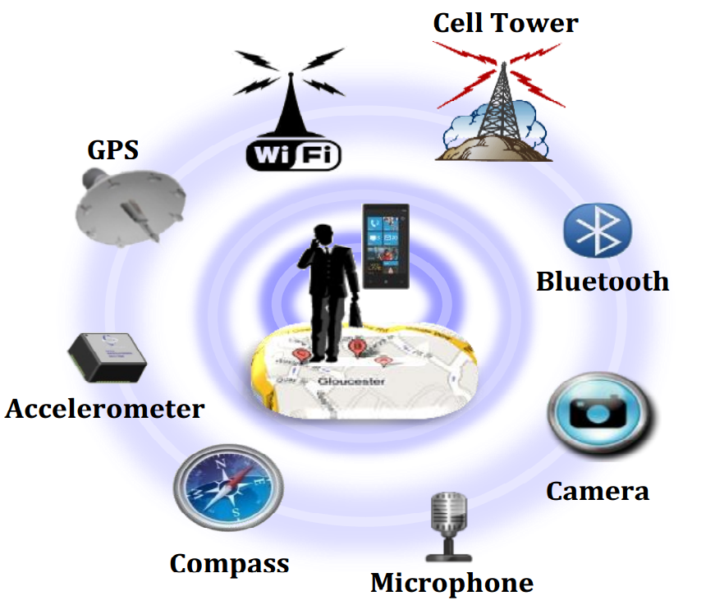
  Trace-driven vision-guided Navigation System
Guide with pre-captured the traces
  Multi-modality
  Navigate within traces
Embrace human vision system
Give up the desire of absolute positioning
Low key the crowdsourcing nature
  Potential to build full-blown map and IPS
Notes:
Instead of navigate a user via the absolution position and on a map, we navigate users w.r.t. previous user’s walking traces.
There are two roles in Travi-Navi: guider and follower.
… actively involve the user by leveraging the HVS.

Slide 6
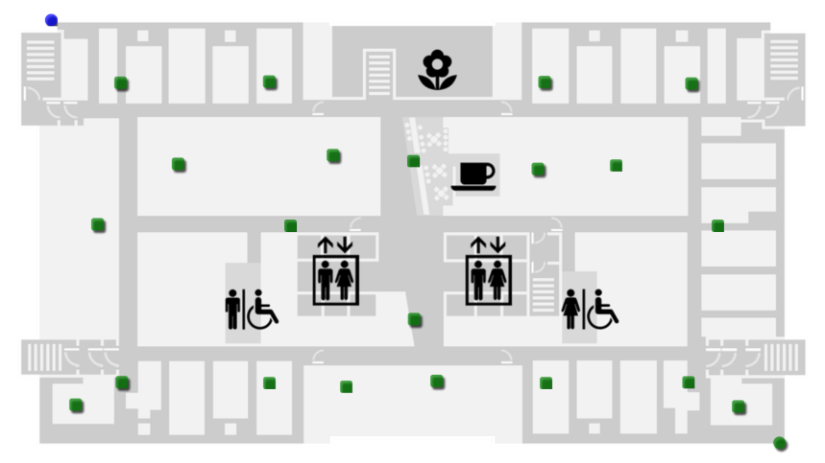




  Travi-Navi illustration: Navigate to McD
Notes:
Let me use an example to walk you through our design and describe the high-level intuition of our work.

Slide 7





  Travi-Navi illustration: Guider
Notes:
To navigate the user, the shop owner (here, Mr. McDonald) walks from an entrance of the mall to his shop. During the walk, pathway images were captured and steps recorded by a mobile or wearable device, mobile phone or Glass. He not necessarily needs to cover all the pathways.

Slide 8




  Travi-Navi illustration: Follower
Notes:
The shop owner shares the pathway images and IMU traces to the user; The user loads the traces into his mobile phone. With the sensor data, our application automatically tracks the user’s progress on the shop owner’s trace. The application presents that landmark images as well as the navigation instructions. The directions are updated on step basis.
We note that the user is not required to take pathway images.

Slide 9
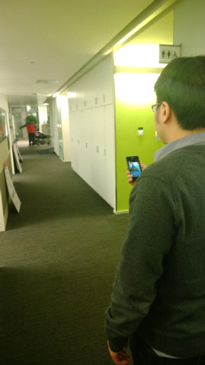
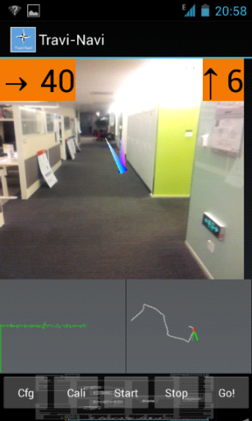
  Travi-Navi: Usage scenario and UI
Directions
  Pathway image
  Remaining steps
  Next turn
  Instant heading
  Dead-reckoning trace
Updated every step
  IMU, WiFi, Camera
Notes:
Here, the left panel shows a usage scenario. The right panel shows the snapshot of travi-navi UI.
The UI shows the pathway images in the center which are updated automatically as the user walks to the destination. It also shows the remaining steps to the next turn (forward 6 steps), and the turning angle (40 degree right turn).
The blue arrow points the current heading direction of the user, while the purple arrow always points upright direction to assist the user to adjust heading direction.

Slide 10



  Design challenges
Efficient image capture
  Reduce capture/processing cost
Correct and timely direction
  Synchronized with user’s progress
Identify shortcut
  From independent guiders’ traces
Notes:
Although the idea is simple, there are many practical challenges.
1) Travi-Navi takes pathway images which incurs high energy cost. Besides, the image processing incurs high time and energy cost as well.
2) To navigate users, we need to present correct and timely directions. Either incorrect or untimely direction may lead users to wrong ways.
3) As users may want to visit multiple destinations, we want our application to automatically identify shortcuts and navigate users to multiple destinations. As the sensor data is collected by multiple guiders without collaboration, finding the shortcuts is a non-trial task.

Slide 11
  Design goals & challenges
Efficient image capture
  Reduce capture/processing cost
Correct and timely direction
  Synchronized with user’s progress
Identify shortcut
  From independent guiders’ traces

Slide 12
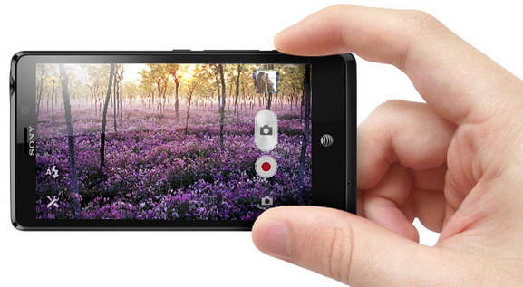
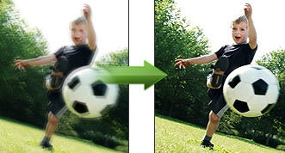
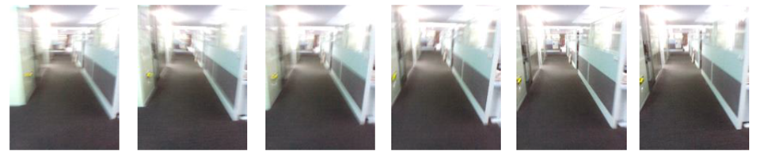


Image capture problems
2~3h battery life
Blurred images
6 images taken during 1 step (6fps)
Notes:
Energy: Image capturing incurs high energy cost. Our phones can only last for 2~3 hours if we take images continuously.
Quality: images taken during the walk can get blurred. Here, we show 6 images taken during one walking step. We see the first few images are blurred. We can use image processing techniques to filter out the blurred ones. However, the image processing incurs extra time and energy cost

Slide 13
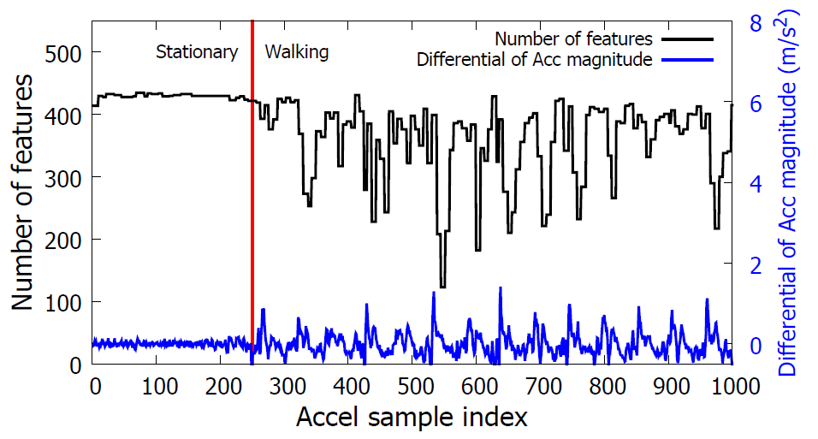
Motion hints from IMU sensors
After stepping down, body vibrates and image qualities drop
Then, it stabilizes! Good shooting timing
Motion hints (accel/gyro): predict stable shooting timing
Image quality
Step down
Notes:
In this figure, the black line indicates the quality of images. We measure the number of features in an image to quantify the quality of the image. The blue line shows the differential of accelerometer magnitude. We observe a spike in the blue line, when the user steps down. As we can see in the figure, the phone will stabilize and image quality is ensured, if we take images before the user steps down.
Thus, travi-navi consults energy-efficient imu sensors to predict stable shooting timing and trigger image capturing every step, right after the phone becomes stable.

Slide 14
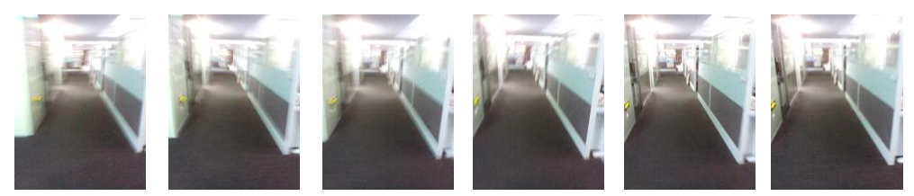
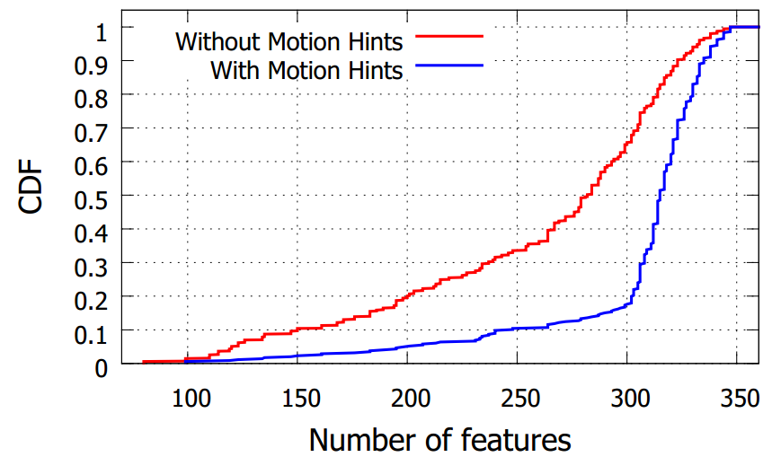
Motion hints help
Avoid “capturing and filtering”: Energy efficiency
Notes:
In the figure, we plot the CDF of number of features. We see that the images taken using motion hints are of higher quality.

Slide 15
Key images
Many redundant images
  Fewer images on straight pathways
Key images: before/after turns
  Turns inferred from IMU dead-reckoning
Notes:
Images taken on step basis. Many redundant images: high energy cost, network traffic
Key images: fewer images on straight pathways, more images before/after turns.

Slide 16
  Design goals & challenges
Efficient image capture
  Reduce capture/processing cost
Correct and timely direction
  Synchronized with user’s progress
Identify shortcut
  From independent guiders’ traces
Notes:
To navigate users, we need to present correct and timely directions. Either incorrect or untimely direction may lead users to wrong ways.

Slide 17


Correct and timely direction
Which image to present?
Different walking speeds, step length, pause
Track user’s progress on the trace
Notes:
Users walking speed might be different. The user may walk slower than the shop owner, or pause in the middle.
Thus, we need to track user’s progress on the shop owner’s trace, and give timely directions.

Slide 18
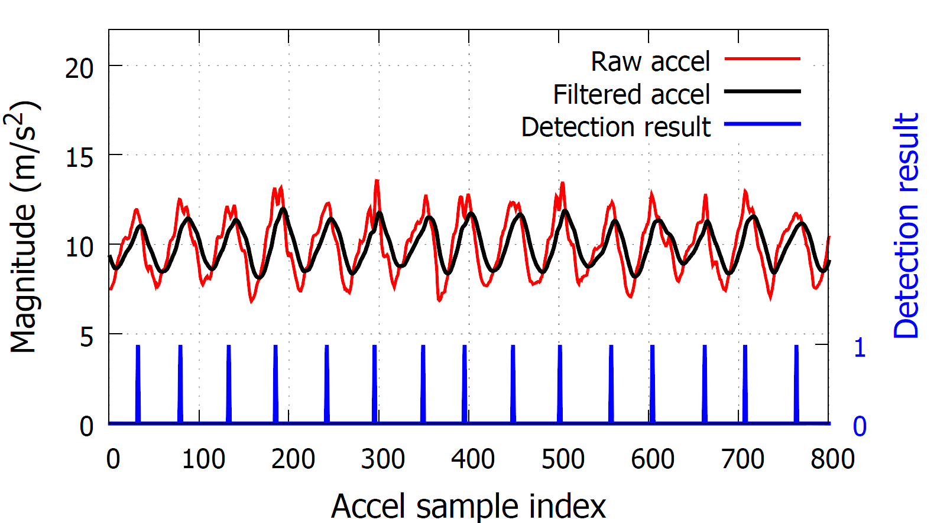
Step detection & Heading
Filter out noises, and detect rising edges
Notes:
We trace users’ progress by counting the steps and measuring the heading directions.
There are many step detection algorithms. In our scenario, users would hold phones in their hands during walking. Thus, we adopt a simple algorithm: looking for the rising edges of accelerometer magnitude after filtering to detect steps.

Slide 19
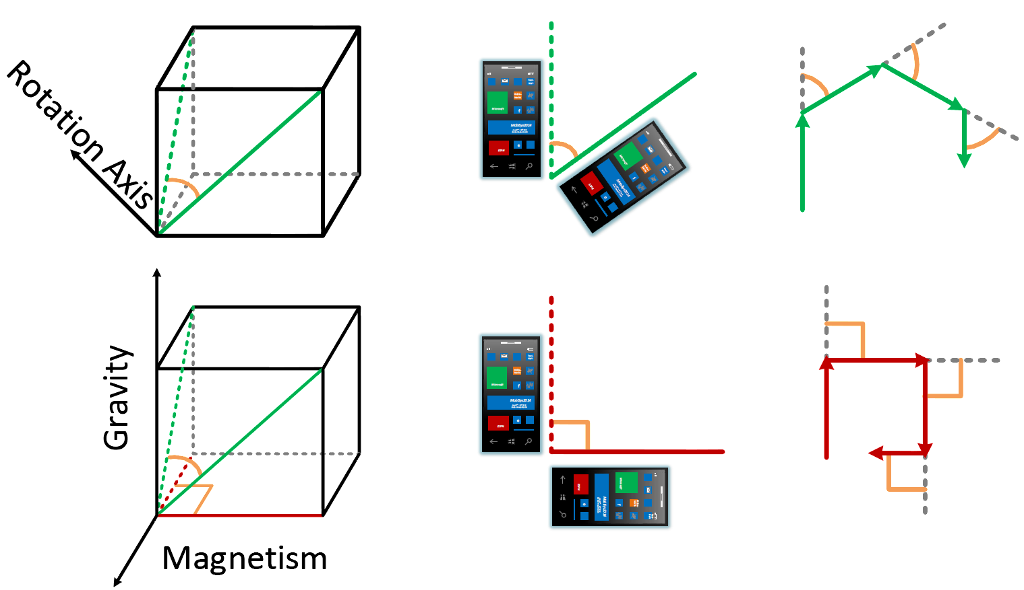
Step detection & Heading
Compass: electric appliances, steel structure
Heading: sensor fusion (gyro, accel, compass) [A³]
[A³ ] Pengfei Zhou, Mo Li, Guobin Shen, “Use It Fee: Instantly Knowing Your Phone Attitude”, MobiCom’14
Notes:
We measure the heading using sensor fusion of accelerometer, gyro, and compass.
Key: estimate the attitude of the phone and always convert to the world coord system. For accurate phone attitude detection, please refer to the A³ paper this afternoon.

Slide 20
Tracking: particle filtering
Use particles to approximate user’s position
  Centroid of particles
Notes:
We use particles to approximate the user’s position.
We update the particles with the step detection and heading measurements.

Slide 21
Tracking: particle filtering
Use particles to approximate user’s position
  Centroid of particles
Update positions
  Noise: step length, heading
  Errors accumulate
Measurements to weight and resample particles
  Magnetic field and WiFi information
Notes:
We then add noises to step lengths and headings to approximate the errors in the measurements.
But due to the noises, errors will accumulate, particles will disperse, and the centroid cannot track user’s position accurately.
We carry out measurements to weight each particle and resample particles to reduce tracking errors.

Slide 22
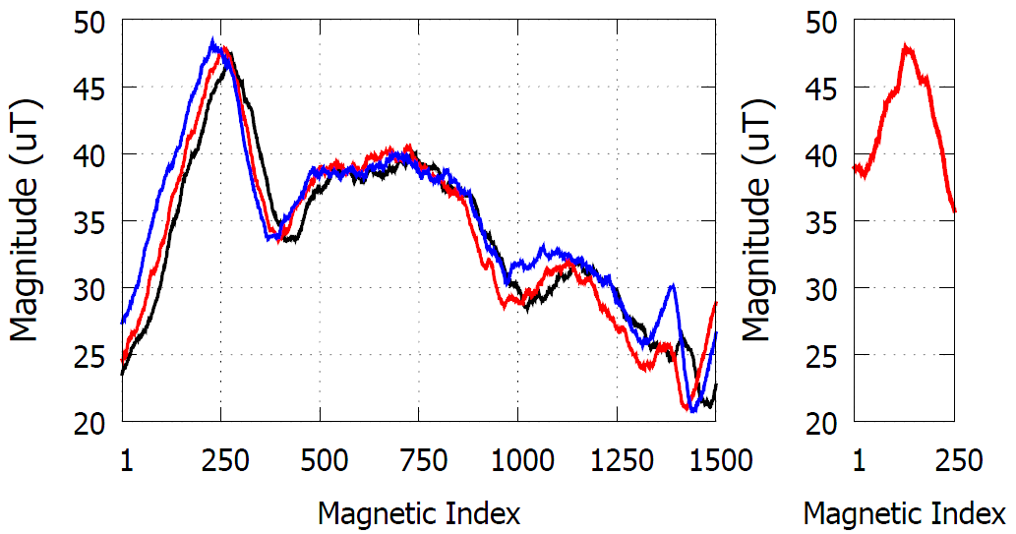
Distorted but stable magnetic field
30m
5m
30m
Notes:
We will observe distinctive patterns as the magnetic field is distorted inside buildings due to steel structures and electronic appliances.
Here, we measure the magnitude of magnetic field along a 30 meter pathway.

Slide 23
Weigh w/ magnetic field similarity
30m
5m
30m
Notes:
If a user walks along the pathway and observes the magnetic field readings as shown in the right figure, then the user is more likely at the green point, compared with the red ones. Thus, we measure the magnetic field readings and filter out the less likely particles and track the user’s position.

Slide 24
Weigh w/ magnetic field similarity
30m
5m
30m
Notes:
Thus, we measure the magnetic field readings and filter out the less likely particles.
After that, we do resampling and add new particles which better approximate user’s position.

Slide 25


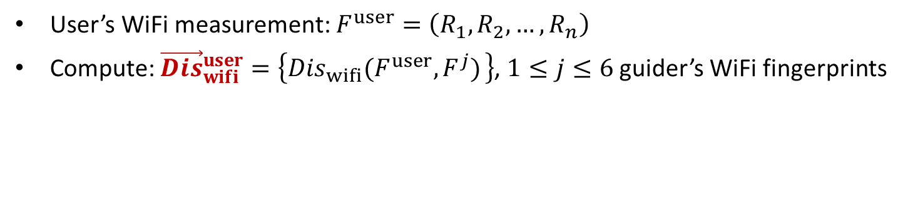
Weigh w/ correlation of WiFi signals
$${\vec{Dis}}_{geo}^{1}$$
$${\vec{Dis}}_{geo}^{2}$$
User’s WiFi measurement: $F^{user}=\left(R_{1},R_{2}, …,R_{n}\right)$
Compute: ${\vec{Dis}}_{wifi}^{user}=\left\{{Dis}_{wifi}(F^{user},F^{j}) \right\}$, $1≤j≤6$ guider’s WiFi fingerprints
Notes:
In this example, each particle uses a vector to measure its distances to the guider’s positions.
With one wifi fingerprint measurement, F^{user}, we use another vector to quantify its wifi distances to the guider’s wifi fingerprint measurements.

Slide 26
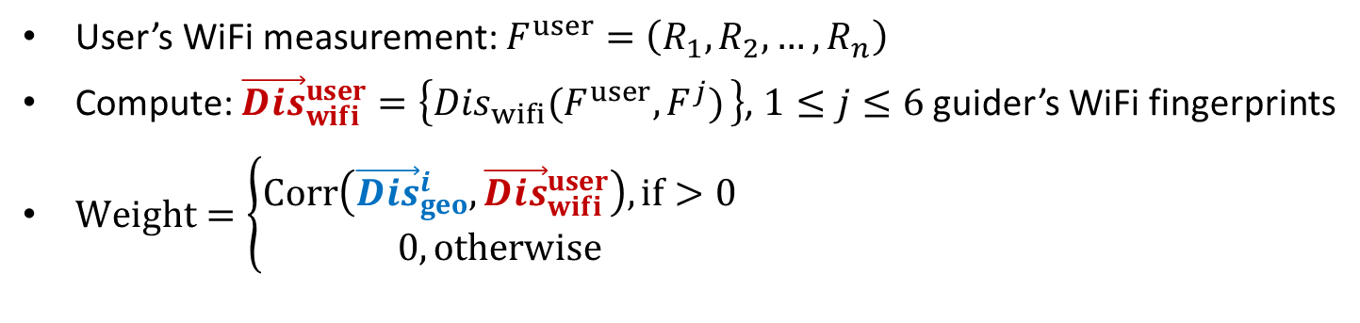
Weigh w/ correlation of WiFi signals
$${\vec{Dis}}_{geo}^{1}$$
$${\vec{Dis}}_{geo}^{2}$$
User’s WiFi measurement: $F^{user}=\left(R_{1},R_{2}, …,R_{n}\right)$
Compute: ${\vec{Dis}}_{wifi}^{user}=\left\{{Dis}_{wifi}(F^{user},F^{j}) \right\}$, $1≤j≤6$ guider’s WiFi fingerprints
$Weight=\left\{\begin{aligned}Corr\left({\vec{Dis}}_{geo}^{i},{\vec{Dis}}_{wifi}^{user}\right), if>0 \\ 0, otherwise\end{aligned}\right.$
Notes:
Suppose that the user’s actual position is detected as the green dot.
Then, we expect a high correlation of the geo distance vector and the wifi distance vector, when a particle is located closer to the actual position.
Thus, we weight each particle using the correlation as measured in the equation.
Since it incorporates multiple fingerprint measurements, it is inherently more robust than those methods that only look into a single wifi fingerprint measurement.

Slide 27
  Design goals & challenges
Efficient image capture
  Reduce capture/processing cost
Correct and timely direction
  Synchronized with user’s progress
Identify shortcut
  From independent guiders’ traces
Notes:
As users may want to visit multiple destinations, we want our application to automatically identify shortcuts and navigate users to multiple destinations. As the sensor data is collected by multiple guiders without collaboration, finding the shortcuts is a non-trial task.

Slide 28


  Navigate to multiple destinations
Identify shortcut
Notes:
We see that travi-navi can navigate a user to a destination, e.g., McD in this example.
What if the user wants to visit H&M from McD? It is not a good idea to ask the user to go back to the entrance and then navigate her from there to H&M.
As the two sensor traces are collected by different guiders (i.e., McD and H&M) without collaboration, our application should be able to automatically identify the shortcut.
Intuitively, since the two traces have the overlapping pathway segments or crosspoints, if we can accurately merge them together than we can find the shortcut.

Slide 29
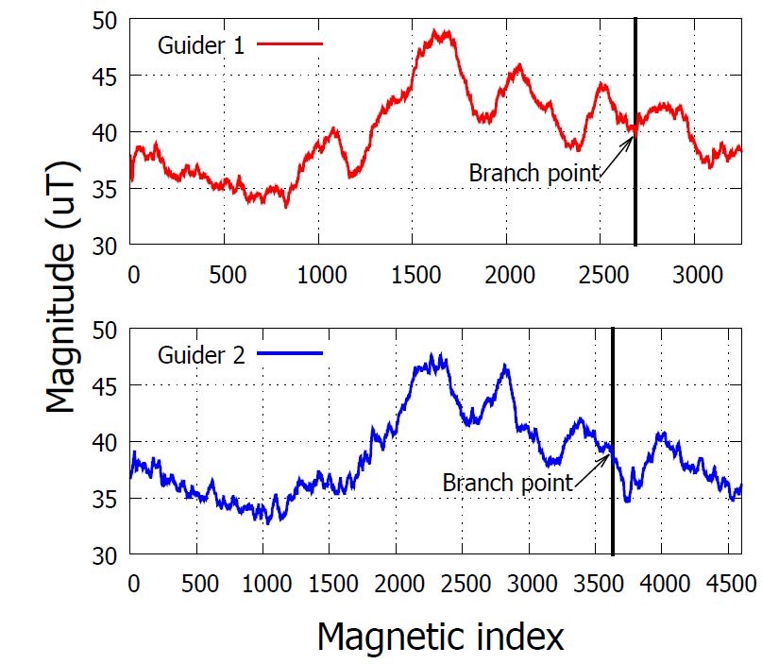
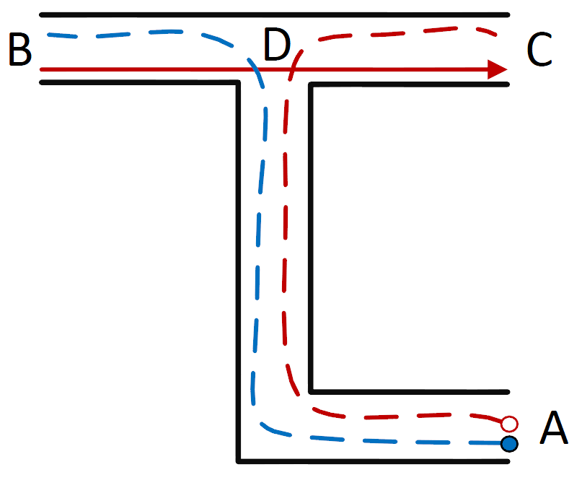
Identify shortcut: overlapping segment
Notes:
We can identify shortcuts if we can detect that they have common pathway segments.
As we mentioned before, we will observe similar magnetic field patterns along the overlapping pathway segments.
In this example, we see that on the overlapping segment A-D, of the two traces A-B and A-C, we will see similar magnetic field readings as plotted in the right figure.
After the branching point, the magnetic fields exhibit different patterns.
Thus, we merge them by detecting measuring the similarity of magnetic reading on two traces.

Slide 30
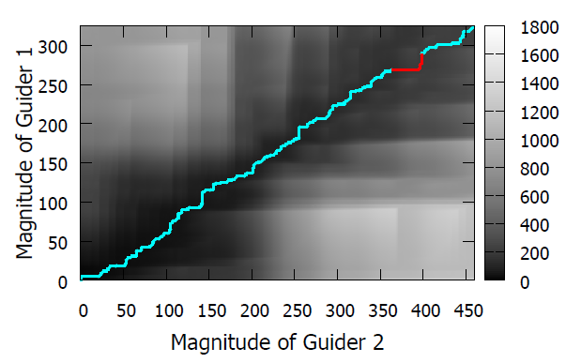
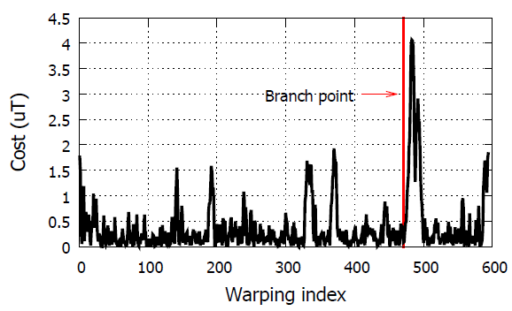
Identify shortcut: overlapping segment
Dynamic Time Warping
Notes:
We measure the similarity using dynamic time warping, to incorporate different walking speeds of two users.
The line in the matrix in the upper figure shows the minimum cost line, and the bottom figure shows the cost involved in each warping operation.
We see a spike in the bottom figure, and that is because after the branching point, there is no good matches on the two traces.
Thus, we set a threshold to detect the spikes, and further filter out false detection with wifi measurements.

Slide 31

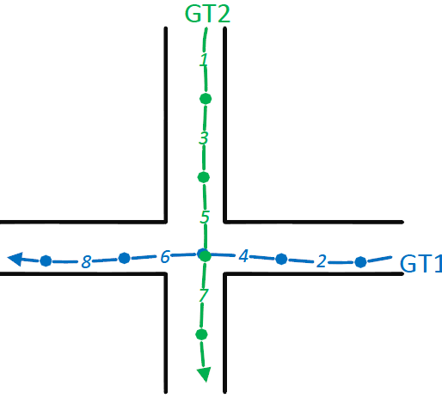
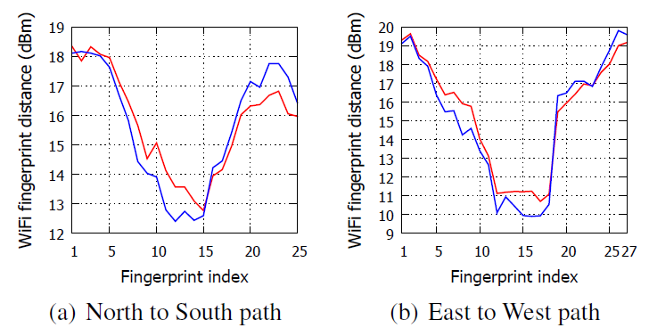
Identify shortcut: crossing point
WiFi distances exhibit V-shape trends mutually
Notes:
The shortcut may also appear as the crossing points as shown in the left illustration.
Intuitively, if we measure the wifi distance from GT2 to GT1, as the user walks down towards to GT1, we will first observe a decreasing wifi distance. After the user crosses the crossing point, we will observe an increasing trend.
Similarly, if a user walks towards GT2, the user will first observe a decreasing trend, followed by an increasing trend.
If the two traces have a crossing point, we expect to see a mutual decreasing-and-increasing trends between their wifi distances.
By detecting such mutual decreasing-and-increasing trends we can detect the crossing point of two traces.

Slide 32



  Merge traces to increase coverage
Notes:
The navigation traces can also stored in a cloud server. The cloud server can use the same shortcut identification techniques to merge the traces to increase the coverage.
By doing so, each shop owner can benefit from cooperating with each other and provide better service to their users.
On the other hand, the user can download the traces from the cloud and navigate to their destinations.

Slide 33
  Design goals & Summary
Efficient image capture
  Reduce capture/processing cost
  Motion hints to trigger image capture
Correct and timely direction
  Synchronized with user’s progress
  Track user’s progress on the trace: sensor fusion
Identify shortcut
  Identifying overlapping segments, crossing points
Vision-guided Indoor Navigation

Slide 34
Evaluation
Implementation & Setup
  6k lines of Java/C on Android platform (v4.2.2)
  OpenCV (v2.4.6): 320*240 images, 20kB
  5 models: SGS2, SGS4, Note3, HTC Desire, HTC Droid
  2 buildings: 1900m² office building, 4000m² mall
  Traces: 12 navigation trace, 2.8km
  4 volunteer followers, 10km
Experiments
  User tracking
  Deviation detection
  Trace merging
  Energy consumption

Slide 35
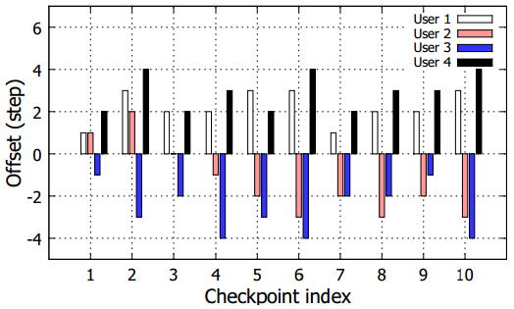
1) User tracking
  Record ground truth at dots, measure tracking errors
  Results: within 4 walking steps

Slide 36
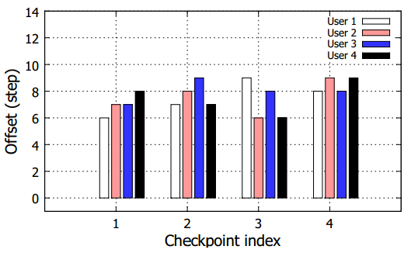
2) Deviation detection
Users deviate following red arrows
Results: within 9 steps

Slide 37
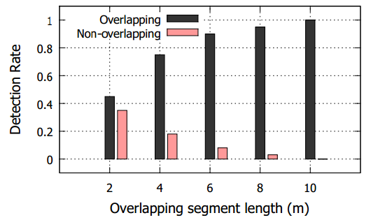
3) Identify shortcut: overlapping seg
100 walking traces with different overlapping segments
>85% detection accuracy, when overlapping segment >6m
100%, when overlapping seg >10m

Slide 38
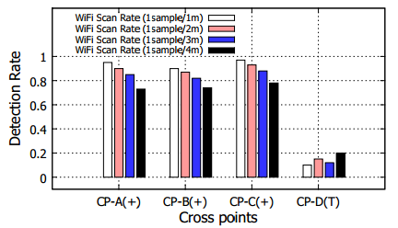
3) Identify shortcut: crossing point
For “+” crossing point, >95% detection rate (1sample/1m)
For “T” point, no mutual trends. Become overlapping seg

Slide 39
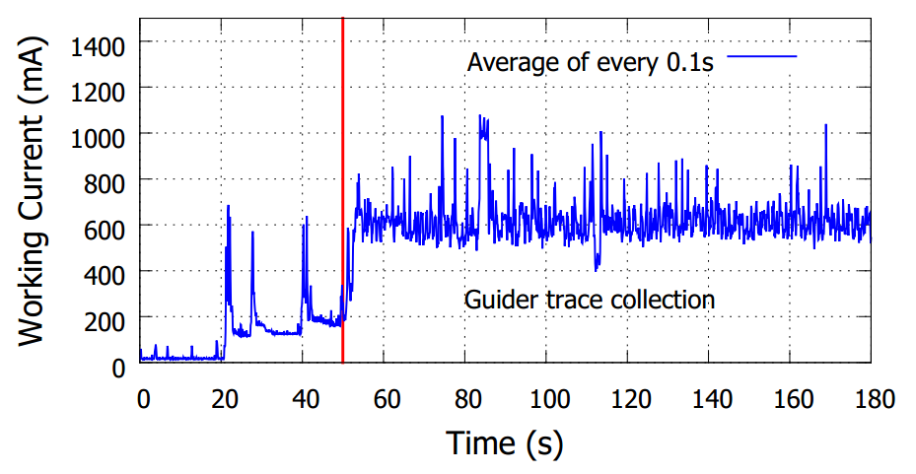
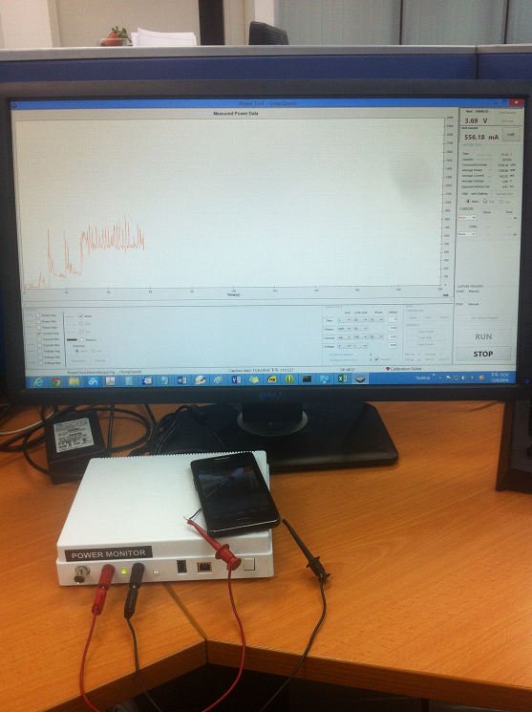
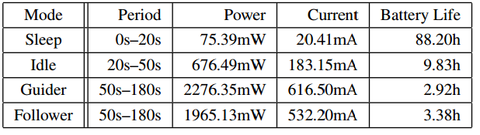
4) Energy consumption
Power monitor
1800mAh Samsung Galaxy S2

Slide 40
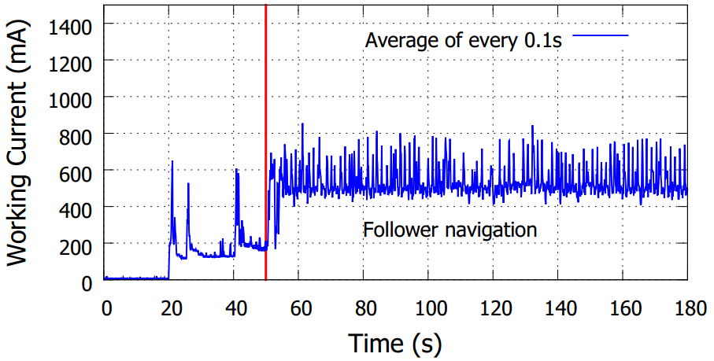
4) Energy consumption
Power monitor
1800mAh Samsung Galaxy S2

Slide 41
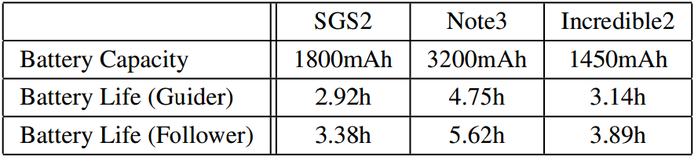
4) Energy consumption
Power monitor
Battery life with different battery capacity

Slide 42
Thank you!
&
Questions
Notes:
Thank you very much!
With this, I’d like to take any questions.

