Slide 1
Traffic-Driven Power Saving in Operational 3G Cellular Networks
Chunyi Peng¹, Suk-Bok Lee¹, Songwu Lu¹, Haiyun Luo∗, Hewu Li²
¹University of California, Los Angeles
²Tsinghua University
ACM Mobicom 2011
Las Vegas, Nevada, USA
Notes:
[Greeting, self-introduction]
Today, I’d like to present our work to design energy efficient cellular networks.

Slide 2
Surging Energy Consumption in 2G/3G
0.5% of world-wide electricity by cellular networks in 2008 [Fettweis]
  ~124Twh in 2011 (expected) [ABI]
  CO₂ emission, comparable to ¼ by cars
  Operation cost, e.g., $1.5B by China Mobile in 2009
Rising energy consumption at 16-20%/year
  Moore’s law: 2x power every 4~5 years by 2030
[Fettweis]: G. Fettweis and E. Zimmermann, ICT energy consumption-trends and challenges, WPMC’08.
[ABI]: ABI Research. Mobile networks go green–minimizing power consumption and leveraging renewable energy, 2008.
Notes:
Our work is motivated by the surging energy consumption at the current cellular network.
It was reported that In 2008, the global cellular network consumed about about 0.5 % of world-wide electricity.
What’s more, the energy consumption is still increasing at a high speed. It is doubling every 4~5 years.
Now Let us take a look how energy is consumed within cellular networks.
============================
%This number is expected to grow up to 124 Twh this year.
%cause an increase of the global carbon dioxide (CO2) emissions and, impose more and more challenging operational cost for operators
From an operation point of view, approximately 3 percent or 600 TWh (Terawatt-hour) of the total worldwide electrical energy is consumed by information and communication tech- nology (ICT) [1]. By the end of 2030, this number is expected to grow to 1700 TWh.
%%
Traditional design of mobile wireless networks mainly focuses on ubiquitous access and large capacity. However, as energy saving ... The escalation of energy consumption in wireless networks directly results in the increase
=======================
Information and communications technology (ICT)
The problem is motivated by the surging power consumption at the current cellular network.
It is reported that In 2009, cellular network consumed about 720 Billion kilowatt hour, which is about 0.5 % of world-wide electricity.
%which is equivalent to burning 1.2Billion barrels of oil
[cellular network consumes about 0.5% of percent of electricity. It is about 720 terawatt-hour,]
(1Twh = 1 billion kwh)
The large energy consumption imposes huge pressure on environment and operational costs. For example, China mobile (one of the biggest operators in China), spent 1.5Billion dollars on power bill in 2009.
(The carbon dioxide emission by cellular network is equivalent to one-quarter of the one by cars. )
[ The report says that the emission of carbon dioxide by cellular networks is comparable to the one by airplanes and is one quarter of the one by cars.]
What’ more, with the rapid growth of mobile market (mobile traffic and network scale),
the energy consumption is still rising at a high speed.
It may double every 4~5 years in the following 20 years.
(e.g. BS from 200,000 to 500, 000 in 2009 in China Mobile)
[Even worse, 10% electricity is consumed in industrialized countries.]
So, obviously, to build a green cellular network turns into an important and urgent task.
Before we talk about any solution, let us first take a look at how electricity is consumed within cellular networks.
=============================================================================================
1. comparable to CO₂ by airplanes or ¼ of the one by cars
Currently, 3% of the world-wide energy is consumed by the ICT infrastructure. ICT: Information and communication technologies, including data center, internet routes, cellular network
which causes about 2 % of the world- wide CO2 emissions
comparable to the world-wide CO2 emissions by airplanes or 1⁄4 of the world-wide CO2 emissions by cars
The number of Base station from 200, 000 to 500,000 in China Mobile
A large scale of Cellular networks, (mobile markets
Ref: The International Telecommunication Union's (ITU's) latest 11th edition of the ICT regulatory report "Trends in Telecommunication Reform Trend

Slide 3
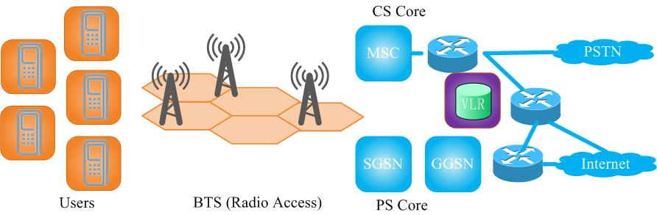
Energy Consumption in Cellular Networks
0.1w
X 5B = 0.5GW
1~3kw
X 4M = 8GW
10kw
X 10K = 0.1GW
<10% (~1%)
Mobile Terminals
>90% (~99%)
Cellular Infrastructure
~80% at BS
The key to green 3G is on BS network
Source: Nokia Siemens Networks (NSN)
Notes:
The cellular network can be partitioned into three parts: client, base station network and the rest of wired infrastructure.
It turns out that Bses consume about 80% of electricity.
So the key to green cellular networks is on base station side.
======================
Here, we can see, The mobile terminals consumes less than 10% of electricity.
On the other hand, More than 90% of energy is consumed by the cellular infrastructure.
More importantly, the base stations consume about 80% of electricity.
That is to say, the key to green cellular network is to green cellular infrastructure, especially, improve the energy efficiency at base stations.
==========================
Data: 3.5 M Bses in 2009. (expected) 9 M Bses in 2014.
This is cellular network architecture.
This is mobile terminals. This is cellular infrastructure.
The infrastructure is made of radio access network (like base stations and radio access controllers in the field) and core networks.
Most researchers have worked on energy efficiency of mobile terminals. However, we can see, though the number of mobile terminals is huge (the phone number reaches 5 billion this year), the single device consumes about little(0.1w) power. So the mobile terminals consumes about a small portion of electricity (less than 10%)
[Note there is no strict number to tell us that the exact energy by mobile terminals.]
On the contrary, the cellular infrastructure consumes more than 90% of electricity. Among them, base stations consumes about 80% energy.
So the key to green cellular networks is to build green cellular infrastructure, especially to improve energy efficiency at base stations.
=====================================================================

Slide 4
Outline
Overview
  Problem and root cause
  Existing solutions
Our solution
  Characterizing 3G dynamics
  Exploiting dynamics in design
  Working with 3G standards
  Evaluation
Summary and Insights
Notes:
In rest of this talk, I will first give you an overview of problem.
After that, I will discuss our solution to green base station network, and finally summarize the work.
%%%% and share some insights.
========================================================================================
The basic idea is simple. Just turn off underutilized base station if possible. But we need to address a lot of detailed problems.
We will answer if the OFF scheme is feasbile (does it hurt cellular network peformance),
What base statation can be OFF?
When to turn them off or on?
How to do that?
How well it works?

Slide 5
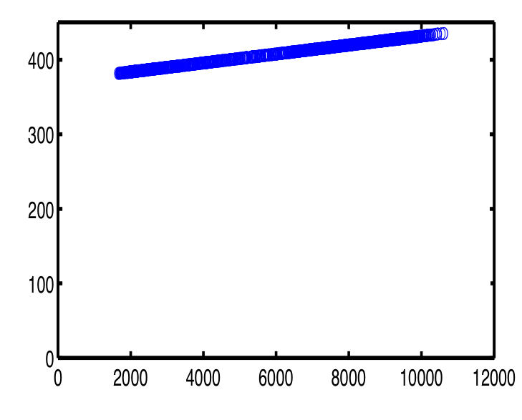
Case Study in a Regional 3G Network
Current
Power (Kw)
Ideal
Load: (#link in 15min)
Power-load curve in a big city with 177 BSes (3G UMTS)
Non-energy-proportionality (Non-EP) to traffic load
Notes:
Let me start with a simple case study.
This figure shows the BS power consumption in respect to its traffic loads in a big city, It has about 177 base stations.
%%X axis is the traffic load and Y is the power.
Ideally, we expect that power consumption should be proportional to traffic load.
%%In extreme cases, zero energy consumption for zero load.
However, in practice, it is still high even when the traffic load is very light.
That is to say, The current BS infrastructure is not energy proportional.
% ------------------
Here, this is an example of power consumption by 3G base stations in a big city.
We used real traces to simulate the power consumption in respect with carrying traffic load by the current cellular network and in the ideal case.
Ideally, energy should be proportional to traffic load.
%In extreme cases, zero energy consumption for zero load.
However, in practice, the power consumption is still high even when the traffic load is very light.
The current cellular infrastructure is not energy proportional.
%It implies that there is much room to reduce the energy overhead.
=========================
Here, this is an example of power consumption by 3G base stations in a big city.
We plot the power consumption with various traffic loads using current scheme and in the ideal case.
[I used real traces to simulate the power consumption by current scheme, our solution and the ideal case.
We plot the curve of power and load with various traffic loads.]
[There are 177 base stations. The blue line is the current energy consumption and the red curve is the one using our solution.]
In the ideal case, we wish that the energy could be proportional to traffic load.
However, in practice, the power consumption is still high even when the traffic load is very light.
It means, base stations consume a large portion of energy, which is not adaptive to traffic loads.
In other words, cellular infrastructure is not energy proportional. There is much room to improve it.

Slide 6
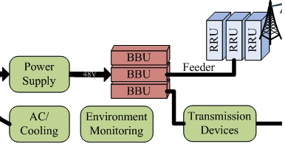
Root Cause for Energy Inefficiency
Each BS is non-EP
2000
Power (w)
l500
l000
500
load
Large portion of consumed energy even
@ zero traffic load as long as the BS is on.
Notes:
But let us explore Why it is not energy proportional.
The first cause is each BS is not energy proportional.
This is a typical BS.
[click]
The power consumption can be divided into two parts. One is transmission related, for example, for radio signal emission and base band processing. The other is for auxiliary devices, like cooling and power supply.
[click]
We conducted measurement to model power consumption at Bses.
Our measurement find out that the transmission power is linearly increasing as traffic load grows. It is because the number of radio link increases, too. But we notice that there still exists a large overhead (see this offset) which is irrelevant to actual loads.
[click]
The miscellaneous/auxiliary power consumption keeps constant if the environment doesn’t change a lot.
And this part is comparable to the transmission power.
%% Here we measure the cooling power because it is the major factor and the measurement on other auxiliary devices makes our solution more important.
%% Here, power is the instant energy.
%% China mobile’s data shows that cooling itself consumes about half of energy.
It shows, when the BS is on, a large portion of energy overhead is consumed.
The smaller the load, the less energy efficient.
============================
It turns out that two factors contribute to it.
The first is that each single BS is not energy proportional. It may consume half of electricity for cooling, which is independent of to traffic load.
On the other hand, the traffic load is highly dynamic. It varies over time and locations.
[CLICK]
So with the large energy overhead at light traffic, the whole system can’t be energy proportional (energy efficient)
=======================================
%But why?
The first reason is that each single BS is not energy proportional.
This figure shows that the base station consumes about half of electricity for cooling. This part is independent of to traffic load at all.
%This figures shows that the base station power breakdown in China mobile. It shows that cooling consumes about half of electricity and this part is independent of to traffic load at all.
(Later I will explain more).
On the other hand, the traffic load is highly dynamic. It varies over time and locations.
(Later we will explore more).
Combine both, we can see the whole system still consumes a large portion of energy when traffic load is light.
Later, we can see this large overhead ould be reduced. Actually, it is what we are doing in this work, to save unnecessary energy consumption and green cellular infrastructure.
==============================================

Slide 7
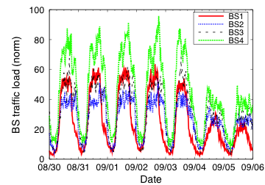
Root Cause for Energy Inefficiency
Traffic is highly dynamic
  Fluctuate over time
  Be uneven at BSes
Low usage at night
Large energy overhead at light traffic => non-EP.
Turn off BS completely to save more energy!
Notes:
But let us explore Why it is not energy proportional.
It turns out that two factors contribute to it.
The first is that each single BS is not energy proportional. It may consume half of electricity for cooling, which is independent of to traffic load.
On the other hand, the traffic load is highly dynamic. It varies over time and locations.
[CLICK]
So with the large energy overhead at light traffic, the whole system can’t be energy proportional (energy efficient)
=======================================
%But why?
The first reason is that each single BS is not energy proportional.
This figure shows that the base station consumes about half of electricity for cooling. This part is independent of to traffic load at all.
%This figures shows that the base station power breakdown in China mobile. It shows that cooling consumes about half of electricity and this part is independent of to traffic load at all.
(Later I will explain more).
On the other hand, the traffic load is highly dynamic. It varies over time and locations.
(Later we will explore more).
Combine both, we can see the whole system still consumes a large portion of energy when traffic load is light.
Later, we can see this large overhead ould be reduced. Actually, it is what we are doing in this work, to save unnecessary energy consumption and green cellular infrastructure.
==============================================

Slide 8
Goals and Challenges
System-wide energy proportionality (EP)
  How to design EP network with non-EP BS components?
Negligible performance degradation
  How to meet location-dep. coverage & capacity requirements ?
3G standard compliance
  How to support energy efficiency w/o changing 3G standard?
Notes:
To build green cellular infrastructure/ (BS network)
There are three design goals and corresponding challenges.
The first goal is to achieve system-wide energy-proportionality.
The corresponding challenge is the each single BS is not energy proportional.
The second goal is that we achieve energy efficiency at no cost or low cost of performance.
The corresponding challenge is to satisfy location-dependent coverage and capacity requirement at the same time.
The third goal is to build a standard compliant solution.
The corresponding challenges is there is little support for energy efficiency in standard.
%%It means, we have to leverage the techniques that are not designed for energy efficiency to build our solution.
=======================================
Our work is to green cellular infrastructure.
We aim to achieve these three goals.
The first goal is to build a energy-proportional network.
%to achieve our goal of energy efficiency.
The second goal is that we achieve energy efficiency at no cost or low cost of performance.
[at no cost or low cost of the cellular network performance]
Last but not least, this solution should be standard compliant. It means, it is practical and easy to deployed at the operators.
But it is challenging to achieve these goals.
energy adaptive to load; 2. satisfy coverage and capacity constraints; 3. 3G standard compliant this way, u can easily attack the existing solutions since they cannot meet all requirements.

Slide 9
Existing Solutions
Optimization-based approach
  Practical issues unaddressed
  Theoretical analysis only
Component-based approach
  e.g., on cooling, power amplifier
  No system-wide solution
  Complement our approach
Clean slate design
  e.g., C-RAN
  Re-architect the 3G infrastructure
  Communication and computation intensive
subject to C1,C2… constraints
Notes:
Let us see how the existing work address the problem.
The existing work can be classified into three categories.
The first one is optimization-based approach. Which formulate energy efficiency into an optimization problem.
%%The downside of this approach is (1) It doesn’t address the practical issues and focus on theoretical analysis.
The second approach is to improve energy efficiency at single component, for example, cooling, amplifier etc.
%%It is not system-wide solution and it is complementary to our approach.
The last one is clean slate design. It deploy the new and more energy efficient infrastructure.
%%For example, CRAN by china mobile. It requires to build a new architecture and it is super computation and communication intensive.
However, all these three approaches can’t achieve all the three goals.
=============================================
The first one is optimization-based approach.
We share the same basic idea to turn off some under-utlized base stations to save power.
But the difference is that these approaches formulate it into optimization problem, for example, using integer programming to find the best user and base station association.
%(like minimize energy consumption with some constraints).
The limitation of this approach is (1) their work is based on idealized or simplistic assumptions and they didn’t address practical issues.(2) On the other hand, they focus on theoretical analysis only . And their algorithm is complicated or centralized. It is hard to deploy.
＝＝＝＝＝＝＝＝＝＝＝＝＝＝＝＝＝＝＝＝＝＝＝＝＝＝＝＝＝
Examples
User-BS association optimization as integer programming [dufkova10]
Cell-size optimization[Bhaumik10]
Cost minimization (tradeoff between power and flow performance) [son10]
Best time to power off (linear programming) [marson09]
====================================================
Current work mostly focuses on the theoretical side by seeking to
solve various forms of optimizations
\cite{marson09,dufkova10,Bhaumik10:BSC,son10}.
Specifically,~\cite{marson09} studies the optimal time to power off
BSes by assuming that all BSes power off simultaneously.
\cite{dufkova10} formulates the optimal user-BS association as a
binary integer programming problem. \cite{Bhaumik10:BSC} studies the
cell-size optimization given the traffic load, and~\cite{son10}
addresses a cost minimization problem that trades-off between energy
efficiency and flow performance. Our work differs from all these
studies in several aspects. First, we use real traces and
measurements, taken from operational networks, in the design and
evaluation, without making idealized or simplistic assumptions.
Second, we take a novel, grid-based profiling approach, which is
distributed rather than centralized. Third, we exploit multiplexing
gains to improve energy savings while early studies do not. Finally,
we identify and assess various practical factors ignored by early
studies in the power-saving operations.

Slide 10
Our Solution Roadmap
A traffic-driven approach that exploits traffic dynamics to turn off under-utilized BSes for system-wide energy efficiency
Characterizing multi-dimensional dynamics
Exploiting dynamics in design
Working with 3G standards
Evaluation
Notes:
We take a traffic-driven approach. We exploit traffic dynamics to turn off under-utilized Bses and provide the sufficient capacity anytime, finally achieve a system-wide energy efficiency.
To achieve that,
We first need to understand traffic dynamics over time and space,
After that, we apply the insight we learn to design our scheme and provide a solution that works with 3G standards.

Slide 11
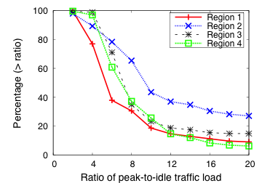
Temporal Dynamics is Pervasive
Low average utilization under dynamic load
  Peak-to-idle traffic is > 5 at 40~80% BSes
Large saving potential for quiet hours
Notes:
We conducted traffic analysis in four regions.
First, it shows that BS has low utilization under dynamic load .
This is 1 week traffic pattern and traffic load is low at night.
We also plot the ratio of the peak traffic to the idle traffic at one BS.
It shows that low utilization is common.
[CLICK]
It implies there is large saving potential for quiet hours.

Slide 12
Temporal Dynamics is Stable
Temporal pattern is near-term stable
  Traffic at each BS is quite stable on a daily basis
  Autocorrelation with 24-hour lag is >0.92 at 70% BSes
  Day-to-day variation (|Curr – Prev|/Prev) is <0.2 at 70% BSes
 | Region 1 | Region 2 | Region 3 | Region 4
>70% BS | 0.92 | 0.93 | 0.94 | 0.94
>90% BS | 0.83 | 0.83 | 0.90 | 0.90
Autocorrelation with 24-hour-lag
Traffic is predictable.
Case for traffic profiling
Notes:
We also find such diversity is temporally stable.
We define day-to-day viriation, as the difference of traffic at the same hour between current and previous day.
The table shows that most BSes has small variation.
The one with large variation is due to the small absolute traffic value.
[CLICK]
It implies that the traffic is predictable and if we make a green decision for one day, it is probably safe to repeat this design in other days.

Slide 13
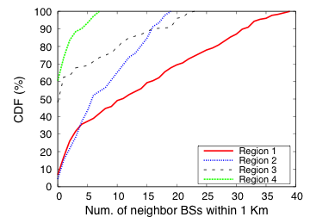
Spatial Dynamics
Deployment varies at locations
  Dense in big cities
    20+ neighbor (<1KM)
Rich BS redundancy ensures coverage.
Notes:
Let us study the spatial diversity.
First we can see the deployment density is different.
BSes are deployed densely, especially in big cities.
%Every 100 to 200 meters, there is a base station in some cases.
[It means that within 1km there is more than 20 neighbor base stations. Within 500 meters, there are more than 10 neighbors.]
We plot the number of neighbor base stations within 1KM. It shows in region 1 and 2, one base stations may have more than 10 neighbors.
[Click]
It indicates there exist rich bs redundancy.
It implies it is safe to turn off some base station, since the area can be covered by other active base stations.

Slide 14
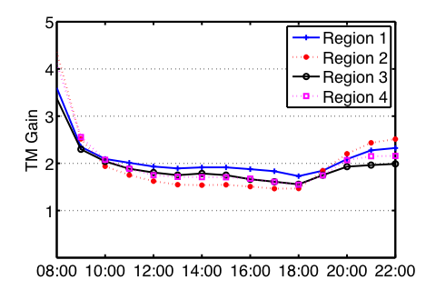
Spatio-temporal Dynamics
Traffic is also diverse at various locations
  Peak hours are different
  Multiplexing gain ~ 2 at peak hours
    Lower bound for the ratio of capacity to traffic
Multiplexing gain: sum(maxTraffic)/sum(traffic)
Large saving potential even at peak hours

Slide 15
Roadmap
Characterizing multi-dimensional dynamics
Exploiting dynamics in design
Working with 3G standards
Evaluation
Notes:
How well it works.

Slide 16
Issue I: How to Satisfy location-dependent Coverage & Capacity Constraints?
Once a BS turns off, clients in its original coverage should still be covered
✗
✗
✗
✗
✗
✔
✗
✔
✗
✗
✔
Even if the total capacity is enough, it may fail to serve mobile clients due to coverage issue.
provide location-dependent capacity
Notes:
Location-dependent capacity

Slide 17
Solution I: Building Virtual Grids
Divide into BS virtual grids
  BSes within a grid cover each other
    Decouple coverage constraint
  Location-dependent capacity meets location-dep. traffic
Virtual BS Grids
turn on/off BSes
s.t. cap >= load
✗
✗
✗
✗
✗
✔
✔
✗
✗
✔
i
✔
r_{i} + d(i,j) < R_{i}
r_{j} + d(i,j) < R_{j}
✗
✗
j
✗
Notes:
Our first design component is to build virtual base station grid.
We use it to decouple capacity and coverage constraints.
We know that the capacity and coverage constraints interact with each other, the solution that satisfy both is always centralized.
But We need to find a simple and distributed solution. So we use grids to decouple coverage constraint first.
We form close base stations into a virtual BS grid. Within a grid, base stations can cover each other.
So Anytime, we just make sure the virtual grid can provide sufficient capacity.
[Click]
The way to form grid is the following. For bs I and j, if they meet these conditions, they belong to the same grid.
That is, the normal operation range is covered by another base station.
Here, this ri is normal operational range and captial Rj is the maximum operation range.
===================================
%Cellular network have to provide sufficient capacity for each location.
%(So when we turn off some base stations, we have to make sure if the rest capacity is large enough.)
However, the capacity and coverage constraints interact with each other, the solution that satisfy both is always centralized.
%To meet this requirement, the optimization-based approaches handle these two constraints together and make solution complicated and centralized.
We want to find a simple and distributed solution. So we use grids to decouple coverage constraint first.
We form close base stations into a virtual BS grid. Within a grid, base stations can cover each other.
So Anytime, we just make sure the virtual grid can provide sufficient capacity.
(Actually, we just turn on/off some physical base stations and make the capacity adapt to the real traffic load.)
The way to form grid is the following. For bs I and j, if they meet these conditions, they belong to the same grid.
That is, the normal operation range is covered by another base station.
Here, this ri is normal operational range and captial Rj is the maximum operation range.

Slide 18
Issue II: How to Estimate Traffic Load?
At what time scale is traffic load predictable?
  Exploit near periodicity over consecutive time-of-the-day
What to estimate? Instantaneous traffic load vs. traffic upper-envelope
  Tradeoff between accuracy and over-estimate

Slide 19
Solution II: Profiling
Estimate traffic envelope via profiling
  Leverage near-term stability
  Reduce runtime computation & communication
  Reduce miss rate via traffic envelope estimation
Sum
24 intervals
Stat
Estimate S, D, EV
Output
Notes:
Our second component is to address when to make decision. We want to avoid the processing overhead in the online decision and also ensure accuracy of the offline decision.
So we leverage the near-term stability and to build traffic profiles for each grid.
We estimate traffic envelops in this following way.
First, we sum up the traffic from all the Bses and divide them into multiple intervals, here we use 24 intervals for a day
%(we also test other intervals, if it is smaller than 4 hours, the performance will be similar)
We track moving average and standard derivation and estimate traffic envelop as the average plus some factor times standard derivation.
We use this traffic profile, rather than real time traffic to guide our on/off scheme.
=========================
It is required to provide sufficient capacity, larger than real time traffic load, anytime.
However, the traffic load is dynamic and it will raise a big processing overhead if we deal with real-time monitoring, communication, computation and coordination.
So we want to reduce the real-time processing via building the maximum traffic load profiles.
Our second component is to address when to make decision. We want to avoid the processing overhead in the online decision and also ensure accuracy of the offline decision.
So we leverage the near-term stability and to build traffic profiles for each grid.
We estimate traffic envelops in this following way.
First, we sum up the traffic from all the Bses and divide them into multiple intervals, here we use 24 intervals for a day (we also test other intervals, if it is smaller than 4 hours, the performance will be similar)
We track moving average and standard derivation and estimate traffic envelop as the average plus some factor times standard derivation.
These formula are similar to the one for RTT estimation in TCP congestion control.
We use this traffic profile, rather than real time traffic to guide our on/off scheme.

Slide 20
Issue III: How to Minimize On/Off Switches?
Frequent on/off switching is undesirable
  Large ramp-up time when on
  Reduced lifetime for cooling and other subsystems
How often to switch on/off?
  Over 24-hour period, consistent with traffic characteristics

Slide 21
Solution III: Smooth Switches
Monotonically increasing ON from idle → peak
Monotonic OFF from peak → idle
1) Find Smax for peak hours
3) Find St when traffic 
✔
✗
2) Find Smin for idle hours (Smin ≤ Smax)
At most ONE on/off switch per BS per 24 hours
Notes:
The selection component is designed to determine what base stations turn off and when to do that.
However, it is a decision for multiple-slots. The complexity is high and the solution is usually unpractical as I declared earilier.
Our solution is to use multiple single slot selection to decouple the time complexity.
To reduce the switching number, our heuristics is to make it smooth as much as possible.
The method is as follows.
[CLICK]
First, we find Smax at peak hours. We will find the most energy efficient combination to provide sufficient capacity.
Usually, it means that we find the minimum # of active BSes with sum capacity >= loads.
[CLICK]
Then, we look for Smin (subset of Smax) at idle hour. Smin must be the subset of Smax.
[CLICK]
When traffic increases, we strictly require that the active set is the superset of the previous one and the subset of the maximal one.
For example, here, we choose … …
%%Smin < St < St+I < Smax; and vice verse
Similarly, we can get active base station when traffic load decreases.
This scheme works well because of the monotonic traffic pattern. Usually, traffic is first monotonically increasing and then monotonically decreasing.
==================================
Now we need to decide what base station will be on or off and when to do that.
However, it is a multiple-slot optimization problem. The complexity is high and the solution is usually unpractical.
For example, it may involve frequent on/off switches, which does harm to device lifetime and is beyond the device capability.
[It is because frequent switch may do harm to device lifetime and also make the solution too complicated and fragile.]
Our one-slot selection is to decouple the time complexity.
Each time, we select active base stations for one slot.
To reduce the switching number, our heuristics is to make it smooth as much as possible.
The method is as follows.
First, we find Smax at peak hours. We will find the most energy efficient combination to provide sufficient capacity.
Usually, it means that we find the minimum # of active BSes with sum capacity >= loads.
Then, we look for Smin (subset of Smax) at idle hour. Smin must be the subset of Smax.
When traffic increases, we strictly require that the active set is the superset of the previous one and the subset of the maximal one.
For example, here, we choose … …
%%Smin < St < St+I < Smax; and vice verse
Finally, we turn on/off each node at most ONCE per 24 hour
Note it may not be best to select active sets in the superset of Smax for the sake of energy efficiency. But it may reduce the number of switch. (device lifetime, operation simplicity etc). It works quite well because because of two monotonic traffic patterns. (first monotonically increases and then monotonically decreases)

Slide 22
Roadmap
Characterizing multi-dimensional dynamics
Exploiting dynamics in design
Working with 3G standard
Evaluation
Notes:
How well it works.

Slide 23
Working with 3G Standard
Expand/shrink coverage at ON Bses
  Cell breathing technique
  When neighbor BSes turn OFF/ON
2
2 OFF
2
1
3
1
3
Migrate clients from OFF BSes to ON BSes
  Before they turn off
  Leverage handover procedures
2
2 OFF
2
1
3
1
3
Coordinate BSes at RNC via Iu-b interface
  Information collector and distributor
Notes:
(We leverage the existing 3G technology to implement our design.)
When neighbor base stations are about to turn off,
for example, here, base station 2
(click) turns off, base station 1 and 3 will expand their coverage to cover the original zone 2.
Here, we use cell breathing technique (existing in 3G standard) to change the coverage.
[Click]
Before Base stations turn off, it has to migrate the ongoing traffic into other active base stations.
The mobile client is associated to base station 2. [Click]
When 2 plans to turn off, it will handoff it to its neighbor base station, here, 1.
This handoff is triggered by network and no change is needed at mobile clients.
After all the mobile clients are served by other active base stations, this base station can turn off.
[or into sleep mode]
RNC (remote network controller) can act as the coordinator.
e.g. manage BS grids, Update and distribute ON/OFF map

Slide 24
Roadmap
Characterizing multi-dimensional dynamics
Exploiting dynamics in design
Working with 3G standards
Evaluation
Notes:
How well it works.

Slide 25
Energy Saving in Four Regions
Use two-month real traces in four regional 3G networks
 | Region 1 | Region 2 | Region 3 | Region 4
Eold (K. kwh) | 9.81 | 2.63 | 8.58 | 9.18
Eour (K.kwh) | 4.64 | 1.4 | 5.94 | 7.03
E Gain (%) | 52.7% | 46.6% | 30.8% | 23.4%
missRatio | 6.7e-4 | 7.9e-4 | 8.2e-4 | 1.9e-5
#BS(weekday) | 34~97 | 8~32 | 79~122 | 104~142
Temporal
Dynamics
Spatial
Dynamicsy
Multiplexing gain
is a major contributor.
allsaving min-weekday max-day min-end max-end
Notes:
This is the result of energy saving in four regions.
[Click]
First, significant power saving is feasible. In a dense area, like region 1, it can reach about 50%.
[Click]
We compare the power saving in different regions and at different time.
Energy saving gain is much larger in denser area rather than in sparse areas. Spatial diversity can lead to about 30% gain difference.
The min/max power saving gain appear at daytime(peak hours) and night(idle hours).
It is clearly seen that temporal diversity can lead to 30-40% difference.
Besides, the power saving gain at peak hours are still high in region 1. It shows that
time multiplexing is the main contributing factor for such a gain. It hasn’t been noticed before.
[we can exploit multiplexing gain to save power]
Compared the min and max power saving gain, we learn that power-saving gain mainly depends on traffic diversity.
Fourth, our results also reveals a downside of our scheme. Due to occasional unavailability of spare capacity, some user requests may be denied. Our detailed trace analysis shows that our profiling scheme fails to catch such rare-case traffic surge in its profile envelope, thus leading to transient overload beyond the provisioned capacity.

Slide 26
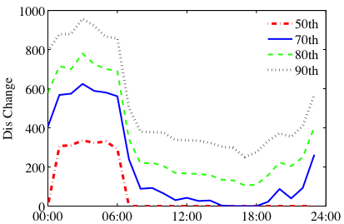
More on Evaluation
Our solution is robust to various parameter settings
  Power models, capacity, coverage, profiling factor, …
Negative impact on clients: More energy for uplink
  Tx range due to ON/OFF scheme
  Example in Region 1
    Negligible at daytime
    <1km at night
    Can be less aggressive
20% ON
60% ON
Range changes in Region 1
Notes:
We also study the negative impacts on mobile clients.
When some Bses turn off, the transmission range may increase and increase energy for uplink transmission at mobile terminals.
However, the negative impact is not that big.
First, uplink is a small portion of mobile traffic.
Second, the example in Region 1 shows that distance change is bounded to 1KM in the worst case.
( can be ignorable at the daytime and it is still bounded to 1KM at night. )
It also implies that our scheme can turn off fewer base stations to reduce the negative effects on mobile clients.
After all, we have achieved high power saving gain, already.
=================================================================
We notice that it only affect the uplink transmissions. But it is less severe as we think. First, the downlink is dominant. The uplink traffic is relatively light.
Secondly, the transmission range increase is not that big.
This picture shows that distance change in region 1. You can see at peak hours, (about 60% BS ON), distance change is ignorable for most mobile clients.
Even at light, the change is smaller than 1 KM. Usually, our mobile phone can handle it because in rural area, the transmission range is usually larger than 1 KM.
It also implies that we may be less aggressive. So far, our solution is to reduce BS as many as we can. The power saving gain is signficant, and of course, we can adjust it for the tradeoff of energy efficiency and other performance.
=========================
However, its impact on the client device is not as severe as it appears. First, the uplink traffic volume is far less than the downlink, which is dominant. The uplink-to-downlink traffic ratio is about 1:8 in the Internet, and 3G networks have similar ratios observed from our traces. Second, the transmission range-extended BSes are conceptually equivalent to the BSes deployed in rural areas, which have larger coverage. Current client devices do not seem to experience severe energy penalty in rural areas. Finally, mobile users are more likely to be uniformly distributed around their serving BSes. Therefore, only a fraction of users will increase their power for uplink transmissions, as shown next.

Slide 27
Summary
It is feasible to build a practical solution to “green cellular infrastructure”
  Especially in the big cities with dense BS deployment
  Especially at late evenings to early dawn with light traffic
Build EP system using non-EP components
  Exploiting inherent dynamics in time and space
Notes:
Here are some insights and lessons I learn.
First, it is feasible to build a simple and practical green cellular infrastructure. The key is to enhance coordination among neighbor base stations.
I believe that such function will be enhanced. Actually, in advanced LTE technology, CoMP ( CoMP, coordinated multiplepoint transmission and reception) is proposed.
Second, we can exploit inherent diversity and even inject artificial diversity to a big system to achieve EP over non-EP nodes. This principle is not only applicable to cellular network, it also make senses in data centers, grid computing, internet, sensor network, and other forms of systems. It is also the beauty of scale.
The lessons I have learnt is to keep it simple
Though the theoretical analysis can provide solid results and it may be easier to get a publication.
However, The operator will care more if it is simple and effective.
Keep it simple and it may be deployed and then it is possible to create big impacts.
(I don’t mean it is not important to learn the potential of one solution. Actually the theoretical analysis may guide our work. But the practical solutions can be applied and have impacts. Usually the practical one is the simple one.)

